Slide 1



Machine learning Models

Slide 2
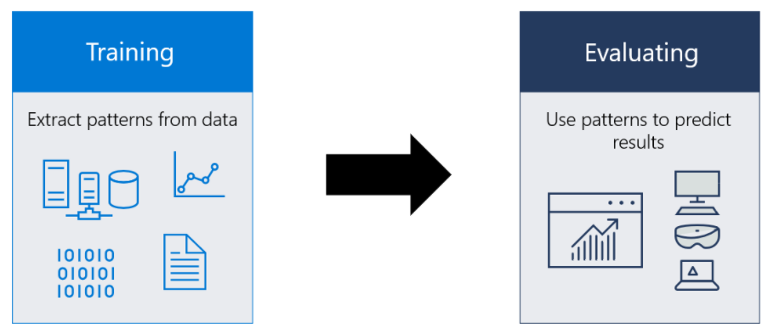
What is a machine learning model?
A machine learning model is a file that has been trained to recognize certain types of patterns in data.
You train a model over a set of data, providing it an algorithm that it can use to reason over and learn from that data.
For example, let's say you want to build an application that can recognize a user's emotions based on their facial expressions.
You can train a model by providing it with images of faces that are each tagged with a certain emotion, and then you can use that model in an application that can recognize any user's emotion.
Microsoft

Slide 3
When to use Machine Learning
Good machine learning scenarios often have the following common properties:
They involve a repeated decision or evaluation which you want to automate and need consistent results.
It is difficult or impossible to explicitly describe the solution or criteria behind a decision.
You have labeled data, or existing examples where you can describe the situation and map it to the correct result.

Slide 4
There are four types of machine learning algorithms:
Supervised learning
Semi-supervised learning
In supervised learning, the machine is taught by example. The operator provides the machine learning algorithm with a known dataset that includes desired inputs and outputs, and the algorithm must find a method to determine how to arrive at those inputs and outputs.
Semi-supervised learning is similar to supervised learning, but instead uses both labelled and unlabelled data. Labelled data is essentially information that has meaningful tags so that the algorithm can understand the data, whilst unlabelled data lacks that information. By using this
combination, machine learning algorithms can learn to label unlabelled data.
Unsupervised learning
Reinforcement learning
Here, the machine learning algorithm studies data to identify patterns. There is no answer key or human operator to provide instruction. Instead, the machine determines the correlations and relationships by analysing available data.
Method aims at using observations gathered from the interaction with the environment to take actions that would maximize the reward or minimize the risk. Reinforcement learning algorithm (called the agent) continuously learns from the environment in an iterative fashion. In the process, the agent learns from its experiences of the environment until it explores the full range of possible states.
©2021 Proprietary and Confidential. All Rights Reserved.
4

Slide 5
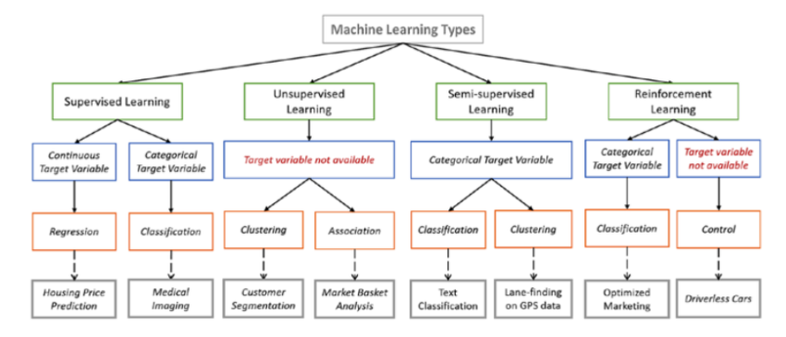
Types of machine learning
https://en.proft.me/2015/12/24/types-machine-learning-algorithms/

Slide 6
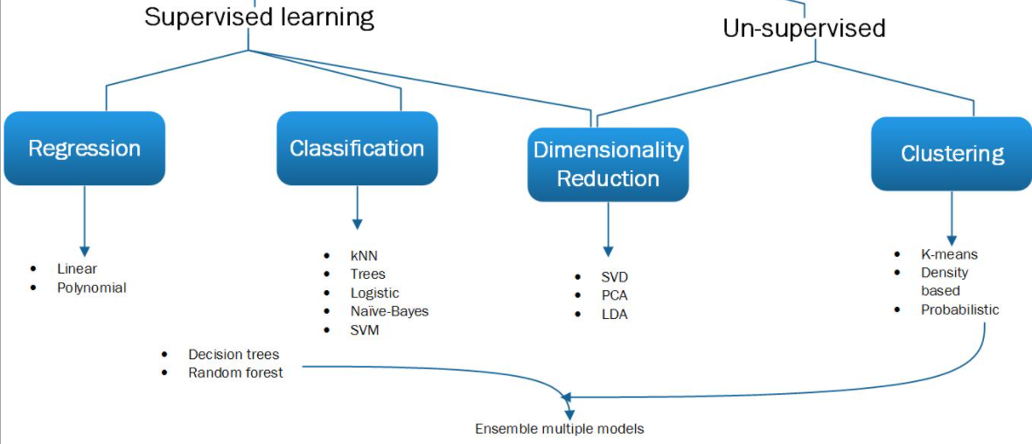
Machine Learning Algorithm:

Slide 7
